Slide 1
Universal open-image predictor
Group 11
Aadish Joshi | asj170430
Piyush Mahatkar | pkm170230

Slide 2
Idea & Inspiration
Inclusive Images Challenge
The motto: To make products that work for people all over the globe. In the field of classification, this means developing models that work well for regions all over the world.
A system trained on a dataset that doesn’t represent a broad range of localities could perform worse on images drawn from geographic regions underrepresented in the training data.
For example.

Slide 3
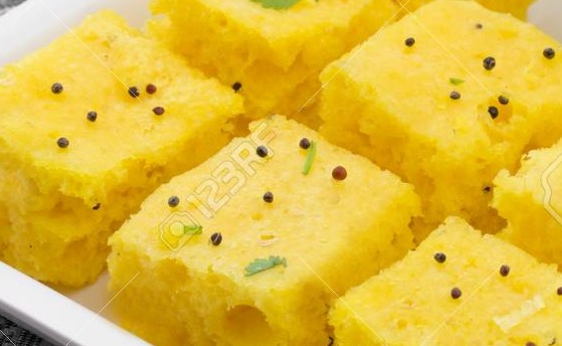
What is this?
Sponge ?

Slide 4
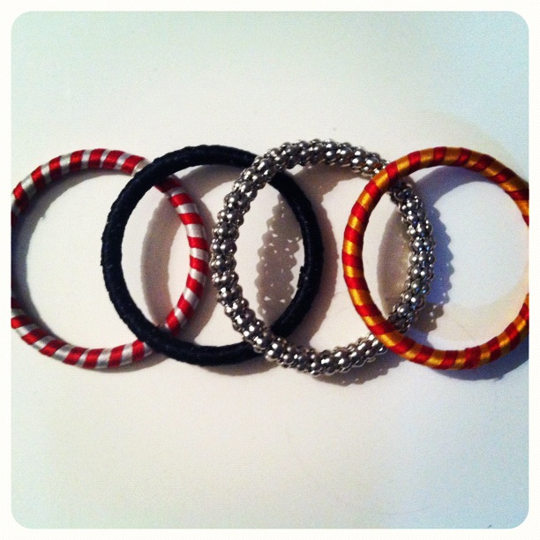
What is this?
Audi ?

Slide 5
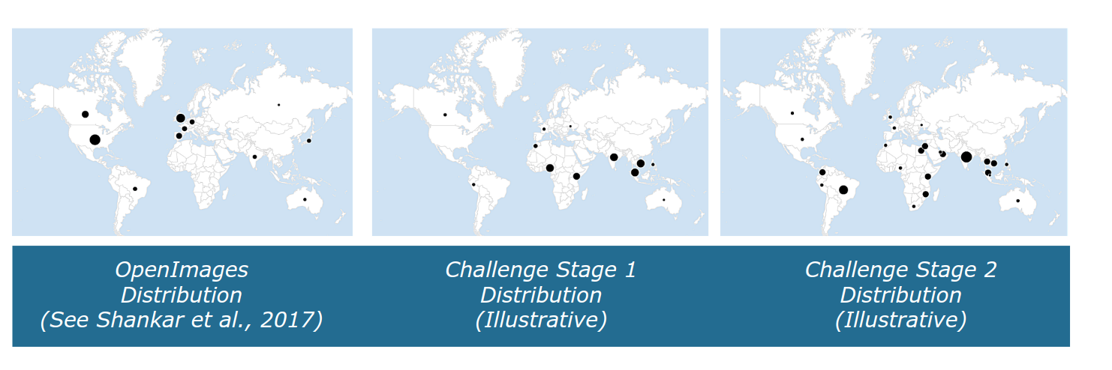
Data Generated Locations

Slide 6
Dataset
Data size: ~16GB.
# validation images: ~40K.
# test images: ~15K.
# label classes : 19998
# human label: 803K[Confidence 1]
# Machine labels : 15M [Confidence 0]

Slide 7
Starting point
We knew that images would come from diverse regions. We used
Data augmentation and ensembling.
https://arxiv.org/pdf/1506.07224.pdf
Some approaches for diversity:
1) Different CNN architectures
2) Different Image sizes
3) Train with/without augmentation
4) Different augmentation schedules

Slide 8
Hardware Utilized
Processor: Intel(R) Core(TM) i5-5200U CPU @ 2.20GHz, 2195 Mhz, 2 Core(s), 4 Logical Processor(s)
GPU: 2x NVIDIA GEFORCE 1080
RAM: 8 GB
HDD: 1x 1TB
In memory: 8GB

Slide 9
Failed / Over Time Experiments
ResNet50, 60epochs, 224X224, adam optimizer 0.001, batch 64, increasing augmentation schedule
~ 4+ hours / epoch
InceptionV3, 30epochs, 400X400, adam optimizer 0.001, batch 32, increasing augmentation schedule
~ 4+ hours /epoch
So we COMPROMIZED.

Slide 10
Dataset under consideration
Data size: ~16GB.
# validation images: ~40K.
# test images: ~15K.
# label classes : 20
# human label: 551K [Confidence 1]
# Machine labels : 512K [Confidence 0]

Slide 11
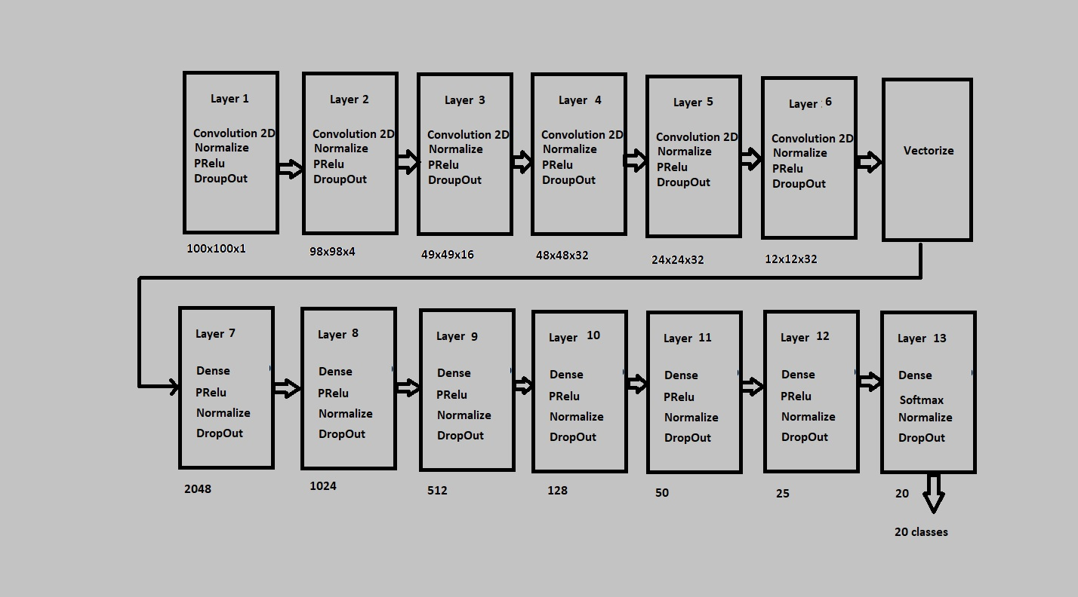
Model for 20 classes

Slide 12
Training process
Train/test split : 6:1 [10K : 2K]
Epochs: 10
Entropy loss: categorical_crossentropy.
Optimizer: RMSProps lr 0.001

Slide 13
References
Squeeze-and-Excitation Networks
https://arxiv.org/pdf/1709.01507.pdf
Deep CNN Ensemble with Data Augmentation for Object Detection
https://arxiv.org/pdf/1506.07224.pdf
DEEP NEURAL NETWORKS UNDER STRESS
https://arxiv.org/pdf/1605.03498.pdf

